Slide 1



Smart University Project Plan
Building the Future of Education

Slide 2







Agenda
Project Charter
Project Timeline
Resource Allocation
Risk Management
Communication Plan
Quality Assurance

Slide 3


PROJECT CHARTER
Project name: Smart University System for Enhanced Learning Experience
Date: 09/17/2024
Project manager: Karim Hassan
Project sponsor: Cairo Technology Center
Purpose : The purpose of the project is to implement a Smart University system that integrates advanced technologies (IoT, AI, etc.) to improve the learning experience, campus operations, and student engagement while reducing administrative overhead.
Description : Design and develop a comprehensive Smart University system incorporating IoT-enabled classrooms, AI-powered administrative processes .
Objective :
To automate administrative tasks and provide real-time access to campus resources.
To improve student engagement and learning outcomes through AI-driven personalized education.

Slide 4
PROJECT CHARTER
Project specification :
Implement smart classrooms with integrated digital learning tools.
Automate administrative tasks such as attendance, scheduling, and resource allocation.
Budget :
The project has a budget of $500,000, allocated as follows:
$350,000 for infrastructure and technology upgrades.
$150,000 for software development, training .
In scope :
Development and deployment of IoT-enabled smart classrooms.
Out of scope :
Changes to the external network infrastructure.
Deliverables :
Fully functional Smart University system with core features deployed.
User training and support documentation for students, faculty, and staff.
Project risk :
Potential delays in acquiring hardware and integrating it with existing systems.

Slide 5


Timeline
TASKS | (2 WEEKS) | (3 WEEKS) | (4 WEEKS) | (3 WEEKS) | (2 WEEKS + ONGOING)
Planning & Research
Design & System Architecture
Development
Testing & Integration
Deployment & Monitoring

Slide 6
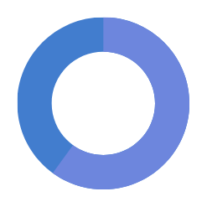

Project Phase 1
100% done
Task: Define Project Scope & Research Solutions
Identify project goals (e.g., smart classrooms, automated attendance, etc.)
Assigned To : Ahmed
Research relevant smart university technologies and AI/IoT solutions .
Assigned To : Mahmoud
Status
Project Phase 2
80% done
Task: Create System Architecture & UI Design
Design smart campus architecture (networking, IoT devices, AI integration)
Assigned To : Ali
Develop UI/UX design for the user applications (students, faculty, admin)
Assigned To : Mohammed

Slide 7
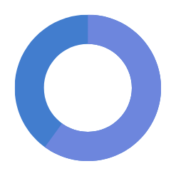

Project Phase 3
60% done
Build Backend, Frontend & Integrate IoT
Develop backend (cloud servers, databases, APIs, AI algorithms)
Assigned To : Joseph
Build frontend apps and integrate IoT devices (sensors, smart cameras).
Assigned To : Motasem
Status
Project Phase 4
50% done
Perform System Testing & User Acceptance Testing
Conduct full system testing (individual components and integration)
Assigned To : Ziad
Perform UAT with selected users (students and faculty) and gather feedback
Assigned To : Shady

Slide 8
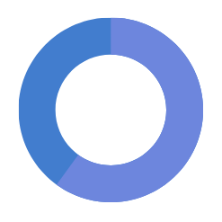
Project Phase 5
Status
30% done
Task: Deploy System & Monitor Performance
Deploy the system gradually, starting with a pilot launch in select departments .
Assigned To : Mohammed
Monitor system performance, fix bugs, and provide user training .
Assigned To : Ahmed

Slide 9
Risk Presentation
 | Risks | Risk level
1 | Data privacy breaches
2 | Limited faculty engagement with technology
3 | Network failures disrupting operations

Slide 10
1. Risk Identification
Risk | Type | Description
Data privacy breaches | Technical | Potential unauthorized access to student or staff data
Limited faculty engagement with technology | Organizational | Faculty may resist or struggle with integrating technology
Network failures disrupting operations | External | Connectivity issues may impact teaching and administrative work

Slide 11
2. Risk Analysis
Risk | Probability | Impact | Severity
Data privacy breaches | Medium | High | High
Limited faculty engagement with technology | High | Low | Medium
Network failures disrupting operations | Low | High | High

Slide 12
3. Risk Response Planning
Risk | Response Plan
Data privacy breaches | Implement strict access controls, regular audits, and encryption for sensitive data
Limited faculty engagement with technology | Conduct technology training workshops, provide ongoing support, and collect feedback
Network failures disrupting operations | Establish backup internet solutions, and conduct regular network stability tests

Slide 13
4. Risk Monitoring and Control
Risk | Monitoring Mechanism | Control Measures
Data privacy breaches | Regular audits, real-time security monitoring | Implement multi-factor authentication, data encryption
Limited faculty engagement with technology | Faculty feedback surveys, usage tracking | Offer continuous technical support and adaptive learning solutions
Network failures disrupting operations | Regular uptime monitoring, network performance analysis | Set up redundant network connections, improve IT response times

Slide 14
5. Contingency Planning
Risk | Contingency Plan
Data privacy breaches | Initiate immediate response protocols, notify affected individuals, strengthen firewalls
Limited faculty engagement with technology | Develop alternative low-tech teaching options, provide personalized tech support
Network failures disrupting operations | Switch to backup network infrastructure, conduct classes via offline methods

Slide 15
6. Documentation and Reporting
Documentation | Reporting Frequency
Risk register, response plans | Weekly updates during project meetings

Slide 16
Project Management Communication Plan
TEAM MEMBER | DELIVERABLE | SCHEDULE | CLIENT | PRIORITY | MEANS OF COMMUNICATION | NOTES
Ahmed | Define Project Scope & Research Solutions | End of Planning Phase | Ricky Jones | High | Team Meeting | All team members must report
Mahmoud | Research Smart University Technologies | End of Research Phase | Ricky Jones | High | Email | Present relevant AI/IoT solutions, must be approved
Ali | Design System Architecture | During Design Phase | Ricky Jones | High | Team Meeting | All team members must report
Mohammed | Develop UI/UX Design | End of Design Phase | Ricky Jones | High | Email | Submit wireframes for approval
Joseph | Build Backend (cloud servers, databases, APIs, AI) | Start of Development Phase | Ricky Jones | High | Email | Backend architecture must be reviewed
Motasem | Integrate IoT Devices | Mid-Development Phase | Ricky Jones | High | Team Meeting | Report progress on IoT integration
Ziad | Conduct System Testing | Start of Testing Phase | Ricky Jones | High | Email | Submit testing results before proceeding to next phase
Shady | Perform User Acceptance Testing | Mid-Testing Phase | Ricky Jones | High | Team Meeting | UAT feedback must be incorporated into the final product
Mohammed | Deploy System in Select Departments | Deployment Phase | Ricky Jones | High | Email | Provide deployment plan for approval
Ahmed | Monitor System Performance | Post-Deployment Phase | Ricky Jones | High | Email | Report on performance and fix issues as needed

Slide 17
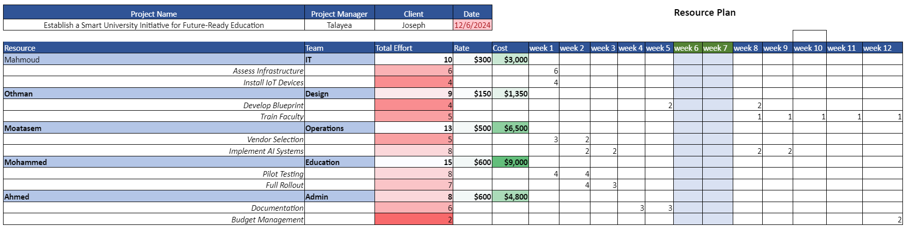

Slide 18

Criteria | Y, N, NA, F, O | Comments
Have standards/guidelines been identified to define the work product? | Y | ISO 27001 and ISO 9001 guidelines followed.
Does the work product format conform to the specified standard/guideline (i.e., Template)? | Y | Uses the official university QA template.
Were any deviations or waivers granted? (Please explain the extent of the deviation or waiver as an observation) | N | No deviations or waivers.
Has project-specific criteria been added? | Y | Criteria for data privacy and IoT security added.
Have the following areas been addressed completely? | F | All areas addressed.
Approval authority | Y | QA Lead and IT Director approved.
Revision approval | Y | Version 1.0 approved by the project manager.
Revision control | F | Revision log maintained in the project file.
Was this assessment conducted as scheduled? | Y | Completed per the project plan timeline.
Software Quality Assurance Plan (SQAP)
Date(s) of Assessment: September 16, 2024
Project: Smart University Initiative for Future-Ready Education
Assessor(s): John Doe, QA Lead
Document Examined: Smart University QA Plan v1.0

Slide 19
Any Question?

